Slide 1

1C Company Sales Forecasting
Khwaja Jalal Sediqi
khwajajalal@gmail.com
www.linkedin.com/in/khwajajalal

Slide 2
Introduction:
This data is extracted from Kaggle website for 1C Company. 1C specializes in development, distribution, and publishing different types of software in Russia.
1C is widely acknowledged as a game developer.
The data contains 1C sales for January 2013 to October 2015 for 60 shops.
Objective:
Explore the data and explain the overall trend in it.
Forecast next few months sales amount based of the available historical data.

Slide 3

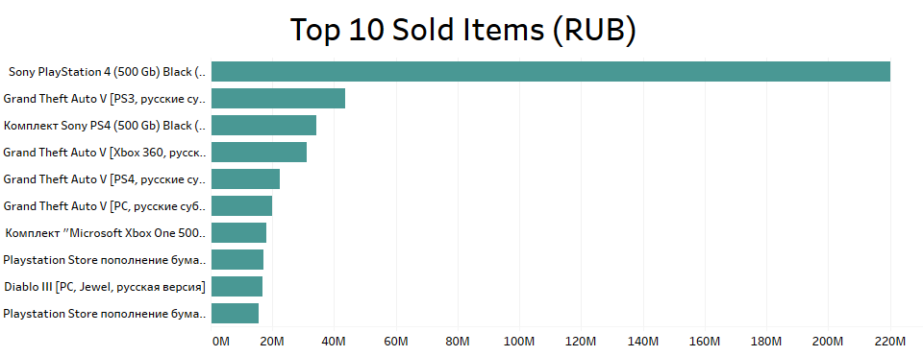


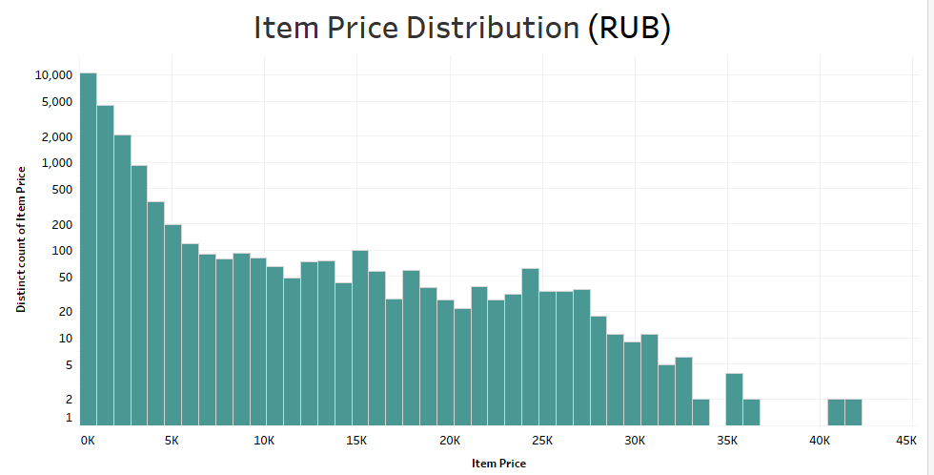

All of the top 10 items are game related. However, Sony Play Station 4 console has the highest amount of sales with more than 200 millions Rubles.
77 Percent of all the items are below 1,000 Rubles (equivalent to 14 USD).
The average item price is 890 Rubles(equivalent to 12.5 USD).

Slide 4
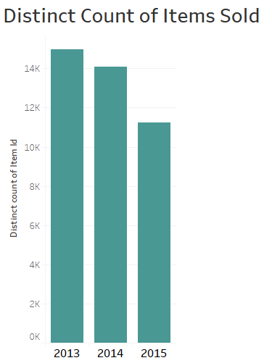
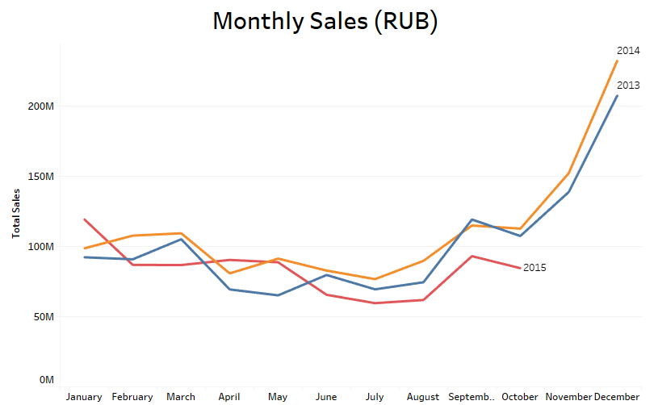
The total amount of sales increased from 2013 to 2014. However, there is no complete data for 2015’s sales. The last month for 2015 sales is October.
The Variety of items or the number of distinct items decreased from 2013 to 2015. 3,722 Items were collected from shelves. However, the total amount of sales did not decrease over time.

Slide 5
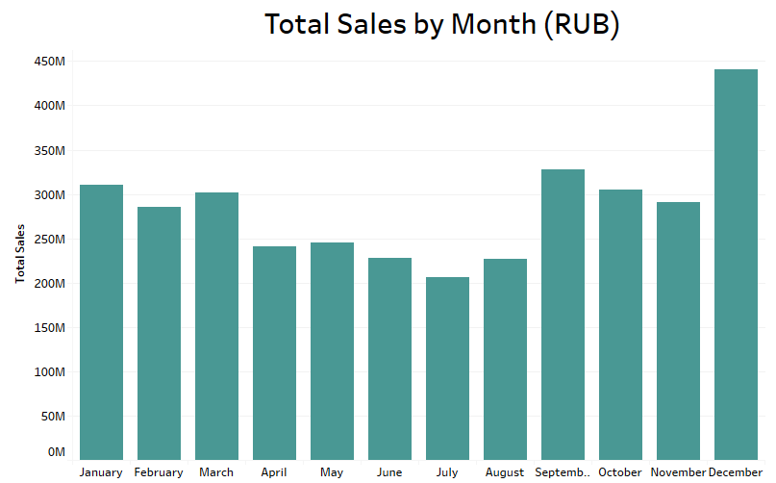
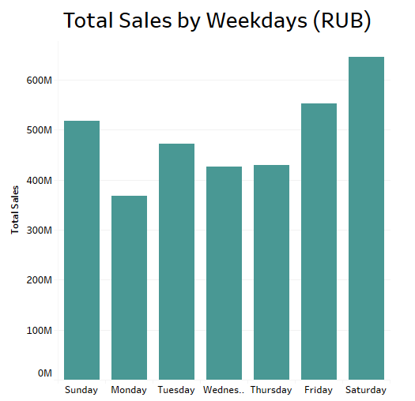
The last four months has the highest amount of sales. December is significantly high because of new year.
Weekend including Friday has the highest amount of sales compared to weekdays.

Slide 6
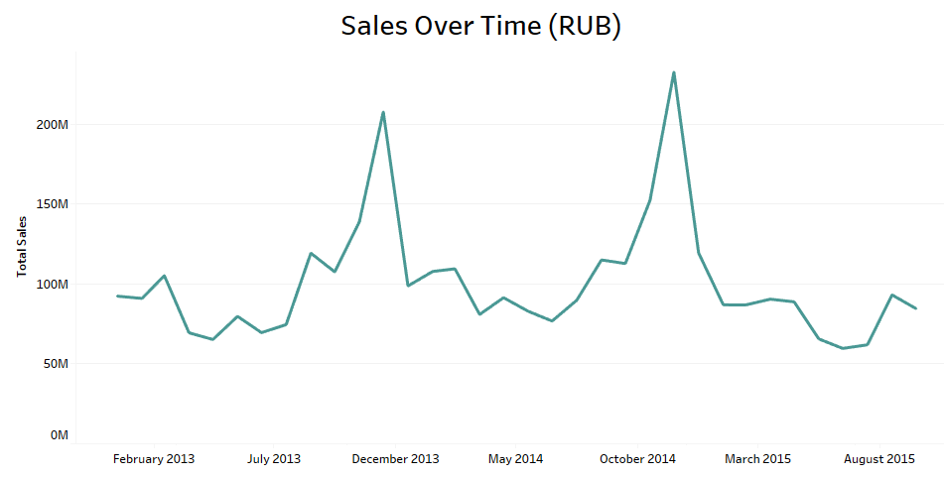
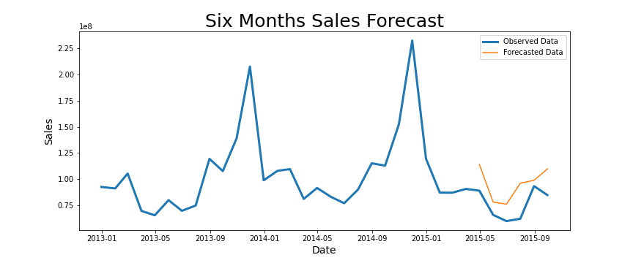
Sales Forecasting
The last six months of data are May – October, and the sales are at the lowest during this period.
After running a time series forecasting model on monthly sales data, the forecasting results from the model was 70% accurate.

Slide 7
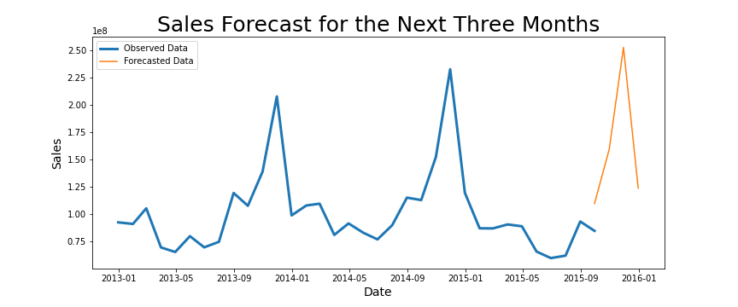


The forecasted monthly sales data mostly follow the same pattern as historical data.

Slide 8
Recommendations
Next Step
Replacing the discarded items with new items with higher potential of sales.
The forecasted sales for next two months, i.e. November and December are very promising. Adding some additional initiatives like holidays sales will increase the total sales even more.
Optimizing the time series model to include additional factors that could impact the sales.

